Slide 2
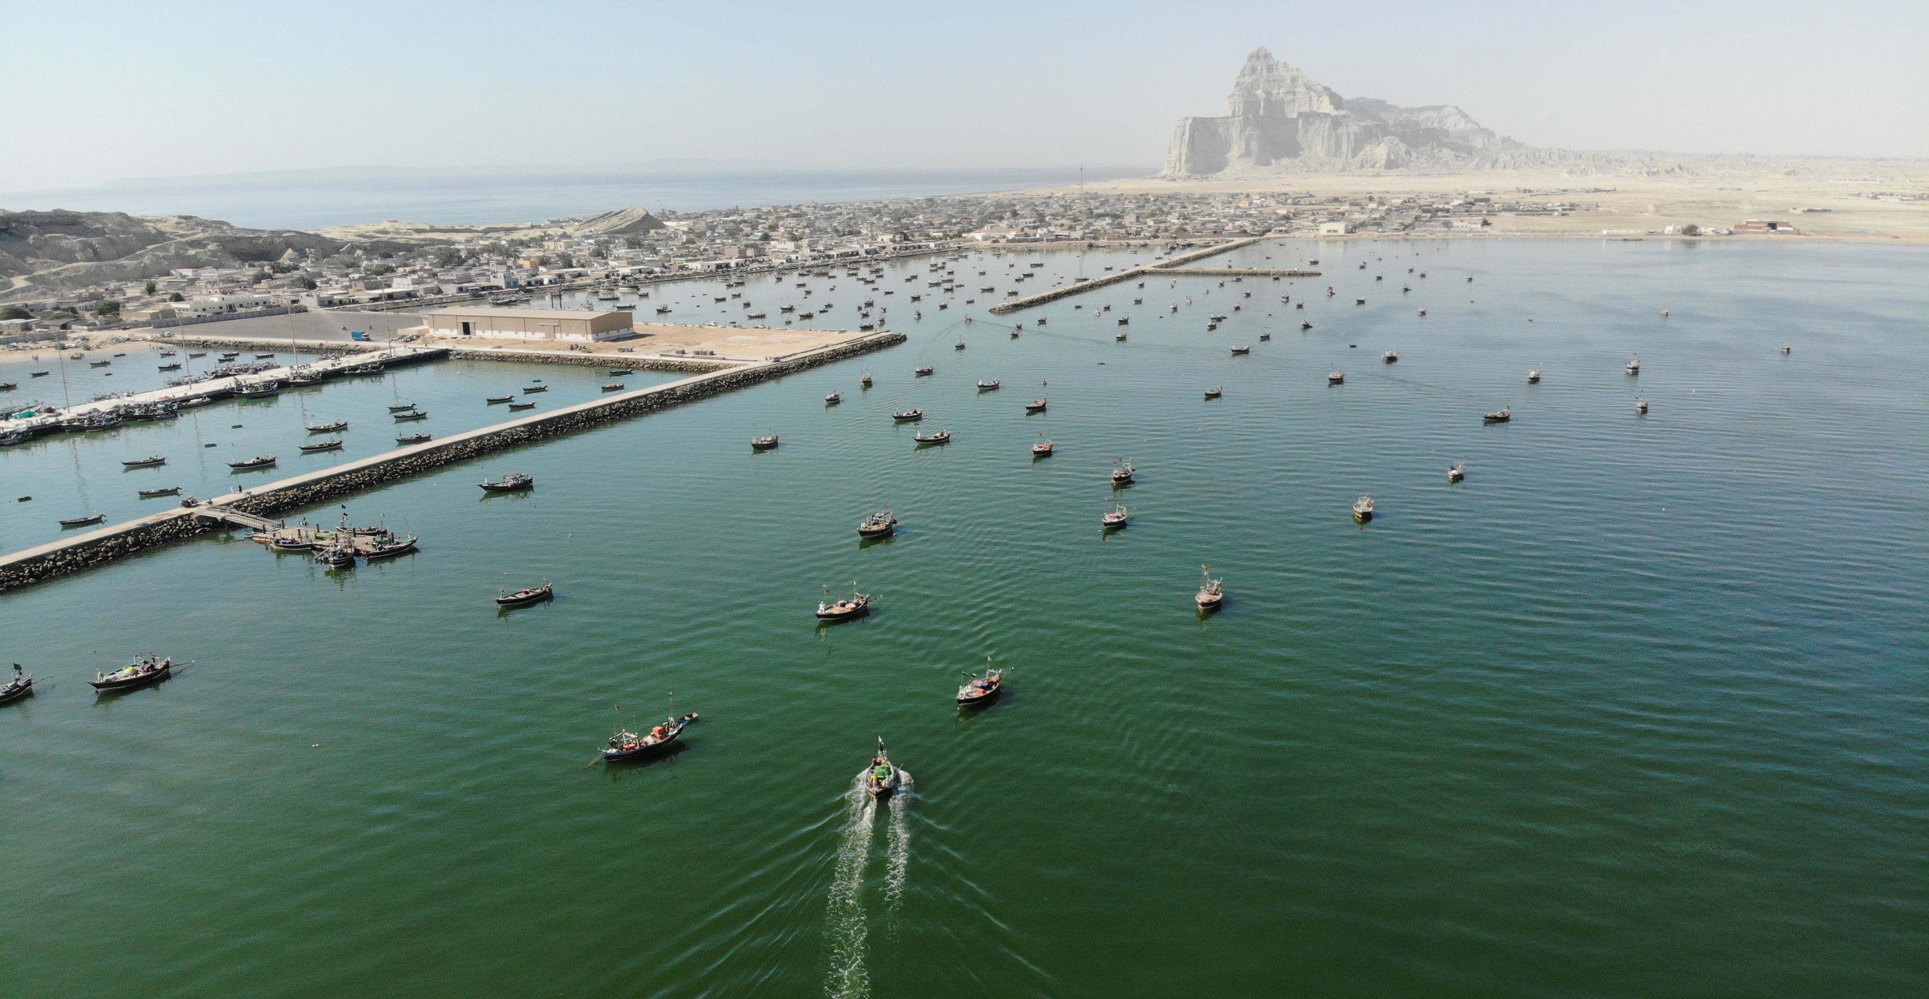
Gwadar - Lasbela Livelihoods Support Project (GLLSP) - II
Surbandar, Gwadar

Slide 3
GLLSP Phase - II
Project Goal:
To develop a sustainable model of decentralized and integrated rural development i.e. poverty, gender, youth, nutrition and climate change sensitive.
Project Objective:
To sustainably increase the incomes and enhance the livelihoods of the rural poor fisher-folks’ families and agriculture households in the project area.

Slide 4
Project Outcomes – GLLSP II
Improved capacities of ultra-poor and poor men and women to move out of poverty
Smallholder farmers and fishing communities benefit from upgraded and inclusive value chains
Improved socio-economic infrastructure

Slide 5
Project Cost Details (PKR) – GLLSP II
IFAD Blend Term Loan : PKR. 10,234.122 million
IFAD Grant : PKR. 508.245 million
GoB : PKR. 1,478.501 million
Beneficiary Cost : PKR. 107.681 million
Total Cost: : PKR. 12,328.549 million
Notes:
The total cost of the project is PKR 12,328.549 million, which include IFAD Blend Terms Loan PKR 10,234.122 million, IFAD Grant PKR. 508.245 million, Government of Balochistan share PKR. 1,478.501 million and Beneficiary share PKR. 107.681 million.
Total USD 75.061 (Loan USD 62.898 million, GoB USD 8.058 million, IFAD Grant USD 3.083, Beneficiary Share USD 1.021 million )

Slide 6
Component 1 – Community Development
Aims to mainstreaming community participation in rural development, poverty graduation and improved farm to market roads.
Capacity building for participatory planning – Union Council Development Planning.
Strengthening community organization and capacity building.
Poverty Graduation through asset transfer, youth skills enhancement and women empowerment
Need-based community physical infrastructure and farm to market roads for enhancing income and social well-being

Slide 7
Component 2 - Fisheries Value Chain Development
Enable 46,000 small fishing persons to sustainably increase income through adoption of improved practices, compliance with buyer standards, improved linkages and better terms of trade.
Organization of fishing communities into cooperatives.
Capacity building through technical and business services through advisory services.
Integration of small fishing person with end buyers/factories
Improved infrastructure (on-shore/off-shore), landing sites, allied facilities and access roads
Policy and regulatory framework improvement

Slide 8
Project Components
Community Development
Capacity Building for Participatory Development
Youth Employment
Asset Transfer
Women Empowerment
Farm to Market Roads
Community Physical Infrastructure
Collaborative Interventions

Slide 9
Project Components
Fisheries Value Chain Development
Jetties and Allied Infrastructure
Fisheries Value Chain Development
Fish Market Access Roads
Capacity Building - Department of Fisheries
Hatcheries and Innovative Aquaculture
Project Management
Project management units
Policy support and TA (Fisheries Policy)

Slide 10
Components

Slide 12
GLLSP-Phase II Snapshots
Duration: 2021-26 (6 Yrs)
Outreach: 100,000 Households
U/C Development Plans: 45 UCs
Economic graduation: 43,500 households
Market access roads: 120 km
Fishermen Beneficiaries: 46,000
Jetties & Allied Infrastructure*: 3 Units
Landing Sites: 40 Units
Notes:
Market Access Roads: 80 kilometers from farm to market and 80 kilometers from fish landing site to highway
*Allied Infrastructure Include: Chill Room (3), Flake Ice Plant (3), Gear Storage (3), Repair Workshop & Fuel Facility (3), Office Accommodation (3), Public Toilet (3)
46,000 fishing person benefits from jetties, infrastructure schemes, concrete path for boat landing 40, RO Plants, and fishing cooperatives, fisheries value chain activities,

Slide 13
SUSTAINABILITY FOR THE PROGRAMME INTERVENTIONS
Three Tier CO/VO/LSO Structure
Poverty Graduation
Community Led (CPI’s)
Fisheries Value Chain and Infrastructure
Rural Roads:

Slide 14
Implementation Arrangement
Communication and Works Dept
Feasibility and Construction of 120 KM Roads
WFP/SUN Movement
Nutrition
Collaborative Interventions
SMP (NRSP)
Capacity Building for Participatory Development, Youth Employment
Fisheries Department
FAO
Asset Transfer & Women Empowerment
Community Physical Infrastructure
Jetties and Allied Infrastructure
Fisheries Value Chain Development
Capacity Building of Fisheries
Hatcheries and Innovative Aquaculture:
Collaborative Interventions
Climate Resilient (Farming & Husbandry)
Business Plan’s (32)
Agribusiness Support Fund (ASF)

Slide 15
Implementation Arrangement
PMU Quetta
PIU Gwadar
PIU Lasbela
Notes:
Project Management Unit (PMU)
Project Implementation Unit (PIU)

Slide 16
DESIGN AND APPROVAL TIMELINE
October 2019
PC-1
November 21, 2019
PDWP (Provincial Development Working Party) approved
December, 2020
February 15, 2021
December 5, 2019
January 1, 2020
Provincial Cabinet approved
CDWP Conditional Approval
Revised PC-1
December 18, 2020
July 5 -21, 2019
GLLSP – II
PDWP (Provincial Development Working Party) approved
CDWP Approved
March 11, 2021
Financial Agreement
Project Design
April 21, 2021
Executive Committee of the National Economic Council (ECNEC)
September 3, 2021
September 23, 2021
Project Account Opened
Project Launching
May 27, 2021
PSC Meeting (Approval of Workplan/Budget and Implementation Manual)

Slide 17
ACHIEVEMENT
November 8, 2021
Meeting with Bahria Foundation
Draft MOU Shared with Department for Approval
November, 2021
PMU, Quetta
PIU Office, Uthal
November 30, 2021
NOC on TOR’s SMP
Advertisement of Staff Hiring
November 6, 2021
PIU Office, Gwadar
Initiate the Hiring Process
November 2021
Initiated Procurement Process of Vehicles
September 28, 2021
BISP (PSC) Data Meeting with P&D Dept Meeting with BISP Data Sharing Committee
October 13, 2021
Introductory Meeting with WFP (Zoom) Sent a formal letter for Proposal for WFP Interventions
November 1, 2021
Received WFP Concept Note
Shared the comments of P&D and PMU on Concept Note
October 11, 2021
Introductory meeting with UNOPS Pakistan for Procurement Services for Feasibility of Jetties
November 2, 2021
Open BPPRA Account for Project
October 29, 2021
Initiated the procurement process of accounting software (TOMPRO)

Slide 18
ACHIEVEMENT
January 31, 2022
Hiring of Staff’s
February 7, 2022
Contract with Vendor for Procurement of Vehicle
January 12, 2022
Nomination of Focal Person from Fisheries
January 12, 2022
Publish EoI for Feasibility Studies of Jetties
January 27, 2022
UNOPS Meeting Consultant for Supervision (Checker and Indentor)
February 1, 2022
Contract with Consultant for Procurement of Accounting Software
January 05, 2022
EOI Opening for Social Mobilization Partner (SMP)
January 11, 2022
Request for Proposal (RFP) issue to NRSP 28/02/2022

